Slide 1
User Interaction
Android Developer Fundamentals V2
Lesson 4

Slide 2
4.2 Input Controls

Slide 3
Contents
Overview of input controls
View focus
Freeform text and numbers
Providing choices

Slide 4
Overview of input Controls

Slide 5
Accepting user input
Freeform text and numbers: EditText (using keyboard)
Providing choices: CheckBox, RadioButton, Spinner
Switching on/off: Toggle, Switch
Choosing value in range of values: SeekBar

Slide 6
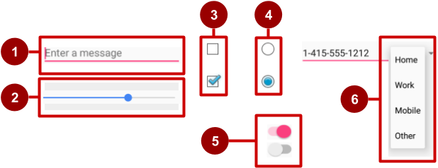
Examples of input controls
EditText
SeekBar
CheckBox
RadioButton
Switch
Spinner

Slide 7
How input controls work
Use EditText for entering text using keyboard
Use SeekBar for sliding left or right to a setting
Combine CheckBox elements for choosing more than one option
Combine RadioButton elements into RadioGroup — user makes only one choice
Use Switch for tapping on or off
Use Spinner for choosing a single item from a list

Slide 8
View is base class for input controls
The View class is the basic building block for all UI components, including input controls
View is the base class for classes that provide interactive UI components
View provides basic interaction through android:onClick

Slide 9
View focus

Slide 10
Focus
The View that receives user input has "Focus"
Only one View can have focus
Focus makes it unambiguous which View gets the input
Focus is assigned by
User tapping a View
App guiding the user from one text input control to the next using the Return, Tab, or arrow keys
Calling requestFocus() on any View that is focusable

Slide 11
Clickable versus focusable
Clickable—View can respond to being clicked or tapped
Focusable—View can gain focus to accept input
Input controls such as keyboards send input to the view that has focus

Slide 12
Which View gets focus next?
Topmost view under the touch
After user submits input, focus moves to nearest neighbor—priority is left to right, top to bottom
Focus can change when user interacts with a directional control

Slide 13
Guiding users
Visually indicate which view has focus so users knows where their input goes
Visually indicate which views can have focus helps users navigate through flow
Predictable and logical—no surprises!

Slide 14
Guiding focus
Arrange input controls in a layout from left to right and top to bottom in the order you want focus assigned
Place input controls inside a view group in your layout
Specify ordering in XML
android:id="@+id/top"
android:focusable="true"
android:nextFocusDown="@+id/bottom"

Slide 15
Set focus explicitly
Use methods of the View class to set focus
setFocusable() sets whether a view can have focus
requestFocus() gives focus to a specific view
setOnFocusChangeListener() sets listener for when view gains or loses focus
onFocusChanged() called when focus on a view changes

Slide 16
Find the view with focus
Activity.getCurrentFocus()
ViewGroup.getFocusedChild()

Slide 17
Freeform text and numbers

Slide 18
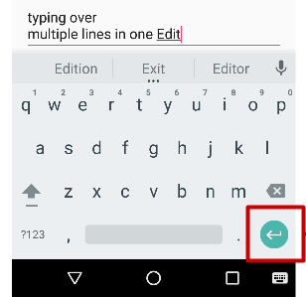
EditText for multiple lines of text
EditText default
Alphanumeric keyboard
Suggestions appear
Tapping Return (Enter) key starts new line
Return key

Slide 19
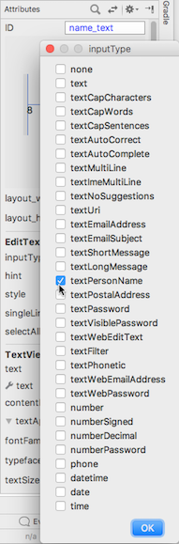
Customize with inputType
Set in Attributes pane of layout editor
XML code for EditText:
<EditText
android:id="@+id/name_field"
android:inputType =
"textPersonName"
...

Slide 20
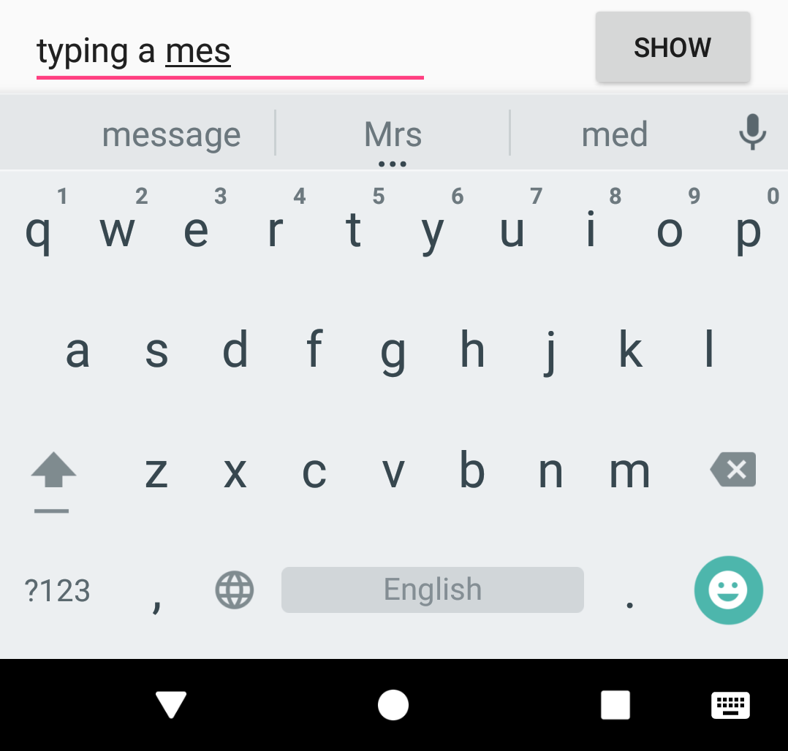
EditText for message
android:inputType ="textShortMessage"
Single line of text
Tapping Emoticons key changes keyboard to emoticons
Emoticons

Slide 21
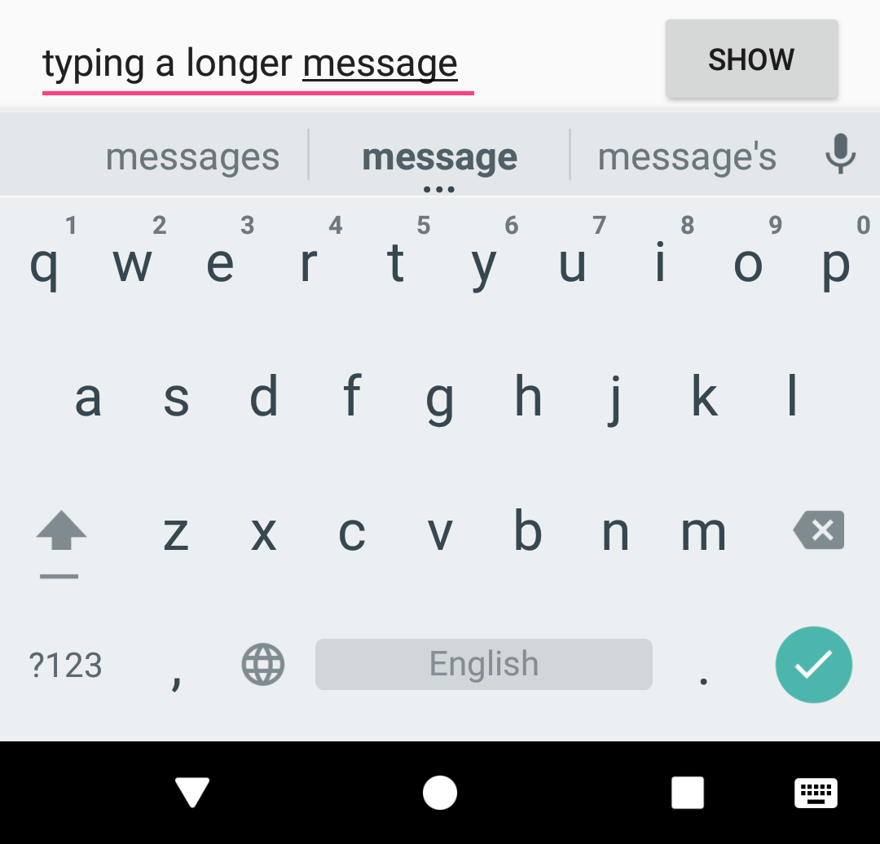
EditText for single line
Both work:
android:inputType ="textLongMessage"
android:inputType ="textPersonName"
Single line of text
Tapping Done key advances focus to next View
Done key

Slide 22
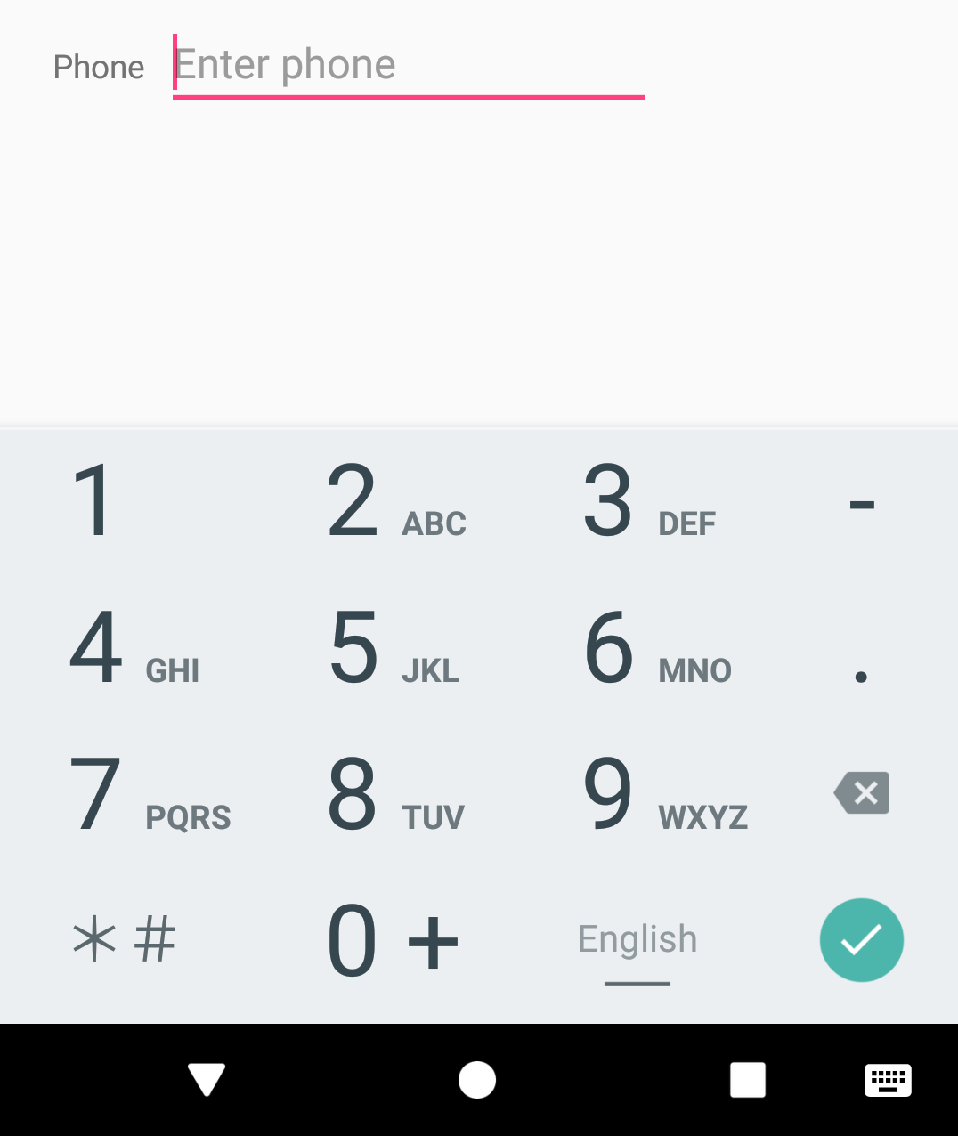
EditText for phone number entry
android:inputType ="phone"
Numeric keypad (numbers only)
Tapping Done key advances focus to next View
Done key

Slide 23
Getting text
Get the EditText object for the EditText view
EditText simpleEditText = findViewById(R.id.edit_simple);
Retrieve the CharSequence and convert it to a string
String strValue = simpleEditText.getText().toString();

Slide 24
Input types
Common input types
textCapCharacters: Set to all capital letters
textCapSentences: Start each sentence with a capital letter
textPassword: Conceal an entered password
number: Restrict text entry to numbers
textEmailAddress: Show keyboard with @ conveniently located
phone: Show a numeric phone keypad
datetime: Show a numeric keypad with a slash and colon for entering the date and time

Slide 25
Providing choices

Slide 26
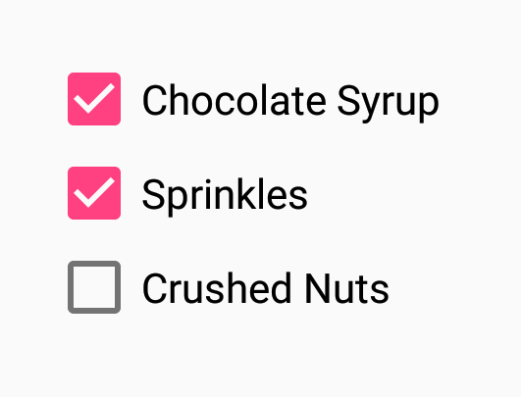
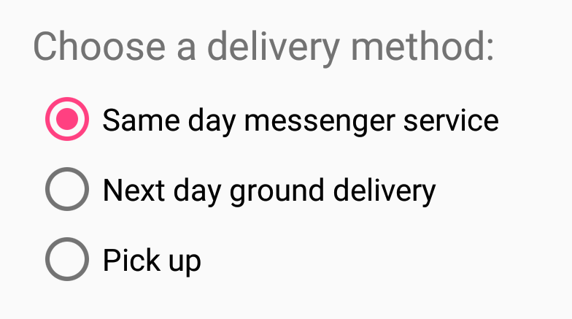

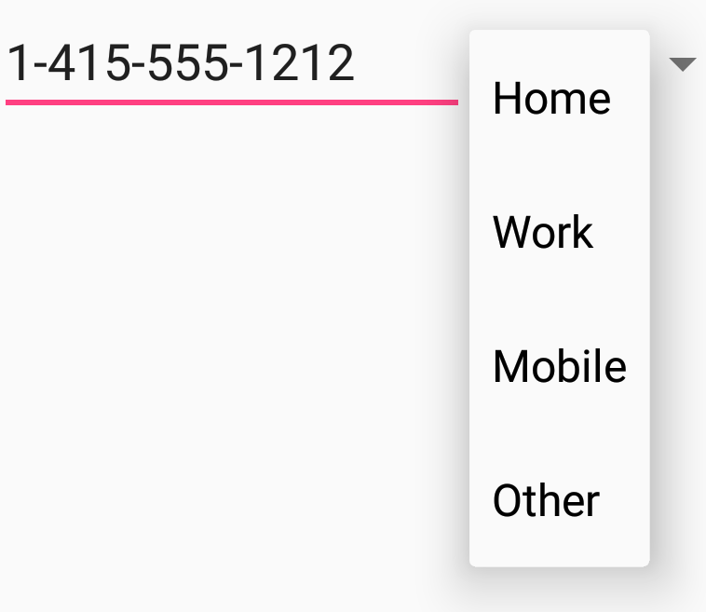

UI elements for providing choices
CheckBox and RadioButton
ToggleButton and Switch
Spinner

Slide 27
CheckBox
User can select any number of choices
Checking one box does not uncheck another
Users expect checkboxes in a vertical list
Commonly used with a Submit button
Every CheckBox is a View and can have an onClick handler

Slide 28
RadioButton
Put RadioButton elements in a RadioGroup in a vertical list (horizontally if labels are short)
User can select only one of the choices
Checking one unchecks all others in group
Each RadioButton can have onClick handler
Commonly used with a Submit button for the RadioGroup

Slide 29
Toggle buttons and switches
User can switch between on and off
Use android:onClick for click handler
Toggle buttons
Switches

Slide 30
Learn more
Input Controls
Radio Buttons
Specifying the Input Method Type
Handling Keyboard Input
Text Fields
Spinners

Slide 31
What's Next?
Concept Chapter: 4.2 Input controls
Practical: 4.2 Input controls

Slide 32
END

Slide 33
CODELAB

Slide 34
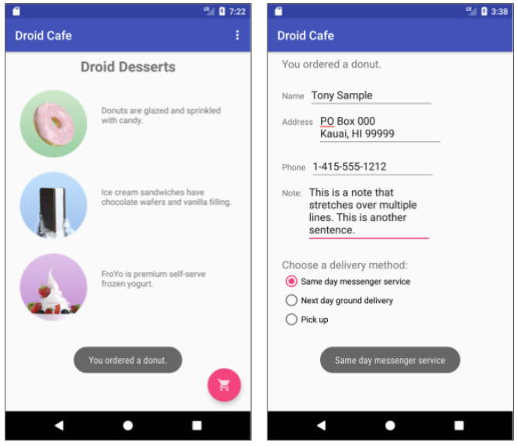
Add Selection Check
Add Spinner
Add Seekbar

